Slide 1


Creating Real-Time Dashboards with Kibana
Special Topics in Software Engineering
Ștefan Cristian
Group 1272E

Slide 2
What Are Real-Time Dashboards?
Dashboards that automatically update when new data arrives
Used to monitor systems, websites, sensors, security events, etc.
Powered by streaming data from logs, APIs, or event pipelines

Slide 3
Why Real-Time Dashboards Matter
Detect problems quickly (errors, attacks, spikes)
Improve decision-making
Understand user behavior in real time
Critical in industries like e-commerce, healthcare, security
Eg:
  Netflix uses real-time dashboards for video streaming performance (source: Netflix Tech Blog).
  Hospitals use real-time dashboards to monitor ICU vitals.

Slide 4
What Is Elasticsearch?
A distributed, NoSQL search and analytics engine
Optimized for high-volume logs and time-series data
Part of the Elastic Stack (ELK Stack): Elasticsearch → Logstash → Kibana

Slide 5
What Is Kibana?
A visualization and dashboard tool
Works on top of Elasticsearch
Used for:
  Log analysis
  Security monitoring
  Business dashboards
  Website analytics

Slide 6
Real-World Uses of Kibana
Airbnb: monitoring service health
Uber: rides data and surge pricing monitoring
Banking: fraud detection and alert dashboards
Healthcare: real-time patient data dashboards
E-commerce: website visitors, sales, and errors

Slide 7
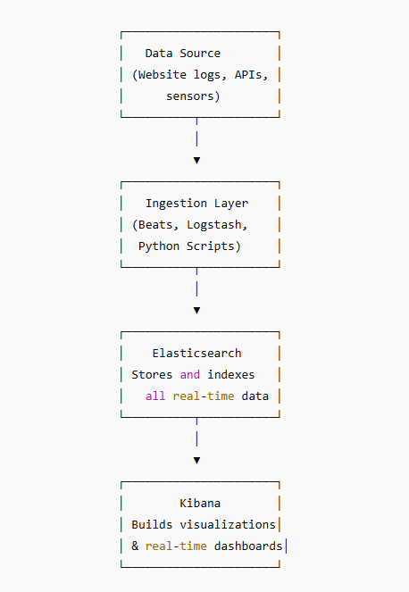
Architecture of a Real-Time Dashboard
Eg: Website visits → sent to Elasticsearch → Kibana updates dashboard every second

Slide 8
How Kibana Dashboards Work
Connect to an Elasticsearch index
Visualize data using:
  Line charts
  Bar charts
  Maps
  Pie charts
  Tables
Combine multiple visualizations into one dashboard
Enable auto-refresh (e.g., every 5 seconds)

Slide 9
Demonstration Scenario
Goal: Show how a Kibana dashboard is created and updated in real time.
We will demonstrate:
  Where to get data
  How to load data into Kibana
  How to create visualizations
  How to build a real-time dashboard
  How to turn on auto-refresh

Slide 10
Thank you!

